Slide 1
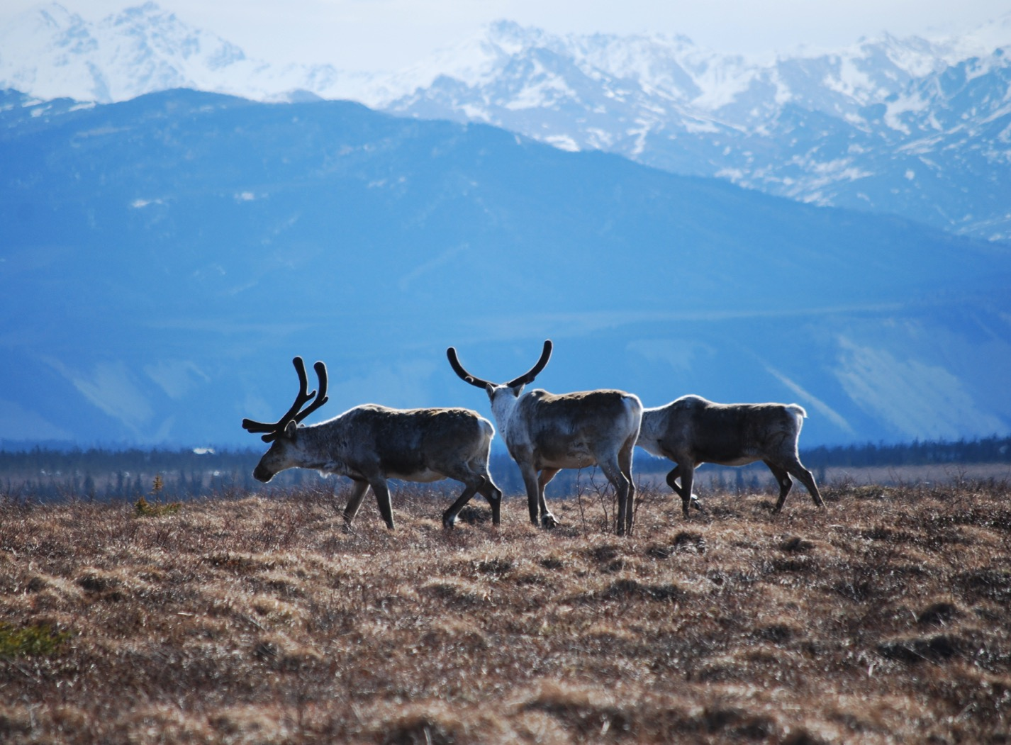
Arctic Boreal Vulnerability Experiment (ABoVE)
2017 ABoVE Airborne Campaign
19 June 2017 (DOY 170)
UAVSAR: Seward Peninsula
Charles Miller, Deputy Science Lead
Jet Propulsion Laboratory, California Institute of Technology
and the ABoVE Science Team For Hank Margolis, Eric Kasichke, Bruce Tagg
NASA HQ
2017

Slide 2
19 June 2017/DOY 170 Seward Peninsula
Daily Summary:
C-20A (N30502) UAVSAR ABoVE CAMPAIGN (CANADA / ALASKA)
REPORT DATE: 19 June 2017
Current Status of Aircraft: GREEN
Current Status of SAR: GREEN
Current Status of PPA: GREEN
Current Deployment Location: Fairbanks, Alaska (PAFA)
Crew: Asher, Barry, Griffith, Choi, T Miller, Lou
Science Coordinator: N Pinto
Science Lead: M Moghaddam
Project Manager: Y Lou

Slide 3
19 June 2017/DOY 170 Seward Peninsula
Daily Summary:
Science Flight (PAFA – PAFA #3) – 6.0 hours
Good flight
Collected 9 of 10 data lines
Missed Line #10
Should be easily collected on tomorrow’s flight
SewPen, Noatak, Ivotuk, Toolik, Coldfoot
Flight Plan – 1133v02
Tough day for the radar, 5 failures but got most of the lines.
Three of the lines were attempted couple of times until acquired. One of them was acquired only 80% and is one of the legacy lines (line 6 in the plan).
Line 10 failed 3 times and was not collected.

Slide 4
19 June 2017/DOY 170 72-Hour Look Ahead
All plans weather dependent
Tuesday 20 June 2017 (DOY 171):
Mackenzie Valley
Wednesday 21 June 2017 (DOY 172):
North Slope
Thursday 22 June 2017 (DOY 173):
Contingency Day
Friday 23 June 2017 (DOY 174):
Transit to Palmdale

Slide 5
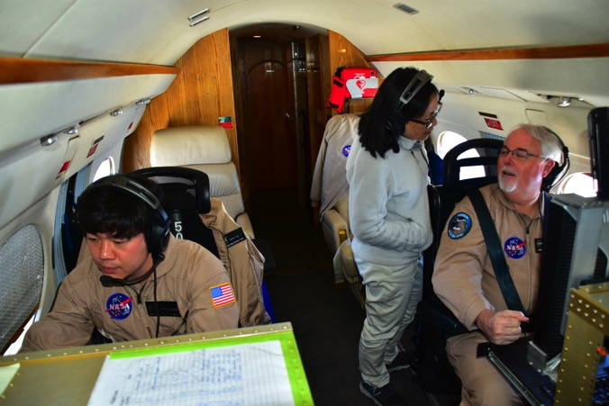
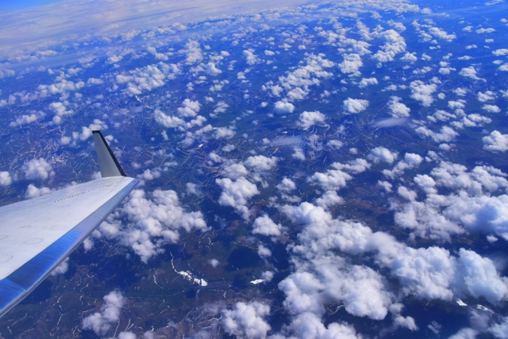
19 June 2017/DOY 170 Seward Peninsula

Slide 6
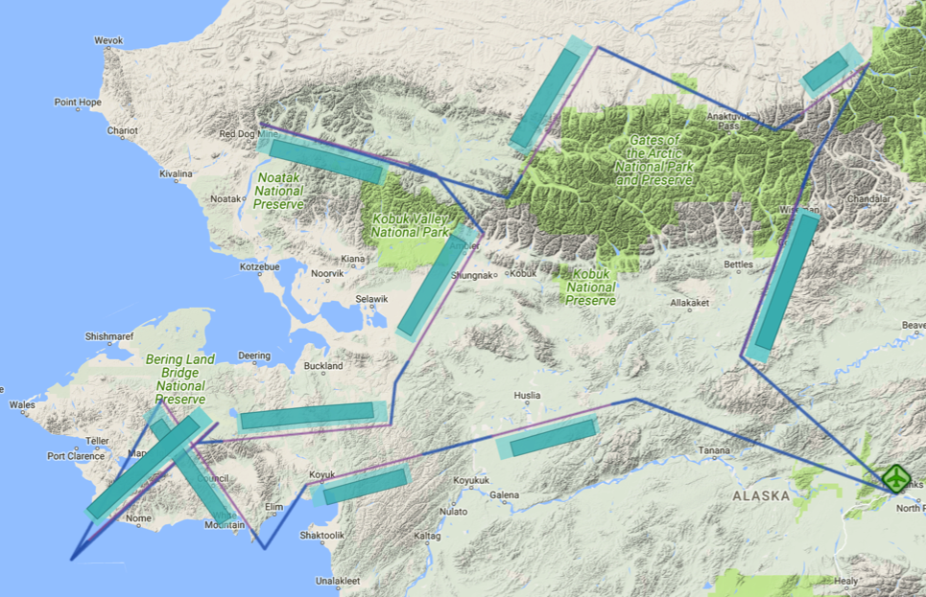
19 June 2017/DOY 170 Seward Peninsula
Flight Plan 1133 v02.1, Report 17067: Fairbanks AK (PAFA) – PAFA
https://uavsar.jpl.nasa.gov/cgi-bin/report.pl?planID=PLAN_17067#flightPlan
Data Acquisitions:
Line 1, ID 25516: Huslia
Line 2, ID 25517: Koyuk
Line 3, ID 32519: Council
Line 4, ID 04806: Teller
Line 5, ID 08502: Kougarok
Line 6, ID 03001: Selawik
Line 7, ID 28508: Noatak
Line 8, ID 03111: Ivotuk
Line 9, ID 05300: Toolik
Line 10, ID 20026: Coldfoot
05300
03111
28507
03001
20026
08502
04806
25516
32519
25517
Flight plan & acquisition segments

Slide 7
19 June 2017/DOY 170 Seward Peninsula
UAVSAR Quick-look products
Line 1, ID 25516_000: Huslia
Line 2, ID 25517_001: Koyuk
Joanne Shimada, JPL
A
B
A. Imagery of the Koyukuk NWR near Huslia shows the transition from hilly terrain to lowland wetlands
B. Coastal mountains give way to the Norton Bay shore south of Koyuk
Notes:
Legacy lines from the Moghaddam IDS projects sampling Interior Alaska near Huslia and Koyuk, respectively

Slide 8
19 June 2017/DOY 170 Seward Peninsula
UAVSAR Quick-look products
A. Line 3, ID 32519_002: Council
B. Line 4, ID 04806_004: Teller
C. Line 5, ID 08502_005: Kougarok
Joanne Shimada, JPL
A
B
C
Notes:
These 3 lines cover NGEE-Arctic SewPen field sites
Note the rugged terrain and fluvial tracings of the vegetation

Slide 9
19 June 2017/DOY 170 Seward Peninsula
UAVSAR Quick-look products
A. Line 6, ID 03001_006: Selawik
B. Line 7, ID 28508_007: Noatak
C. Line 8, ID 03111_008: Ivotuk
Joanne Shimada, JPL
A
B
C
Notes:
(L to R) The wetlands of the Selawik NWR give way to the southern edge of the Brooks Range
The Noatak River runs through the middle of this segment. The Laboda group have many burn measurement sites in this region
(L to R) The northern edge of the Brooks Range opens onto the North Slope foothills and the flux tower at Ivotuk

Slide 10
19 June 2017/DOY 170 Seward Peninsula
UAVSAR Quick-look products
A. Line 9, ID 05300_009: Toolik
B. Line 10, ID 20026_010: Coldfoot (radar flat lined)
C. Line 10, ID 20026_011: Coldfoot (radar flat lined)
Joanne Shimada, JPL
A
B
C
Notes:
SAR imagery of the Toolik Lake LTER site, including the NEON intensive observation area
B & C. The radar flat lined 3x during acquisition of the Coldfoot line. Line not successfully acquired

